Slide 1
Success in Y11
English

Slide 2

What qualifications is my child studying for?
Most pupils are studying for two GCSEs:
GCSE English Language
GCSE English Literature
Some students are studying English Functional Skills as a separate qualification instead of English Literature
http://www.aqa.org.uk/subject/english/gcse

Slide 3
When are the exams?
12th May 2027 - English Literature paper 1
19th May 2027 - English Literature paper 2
24th May 2027 - English Language paper 1
8th June 2027 - English Language paper 2

Slide 4
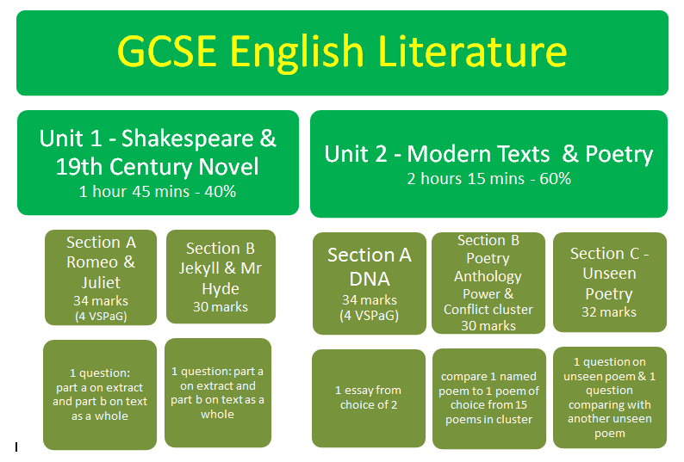
Macbeth

Slide 5
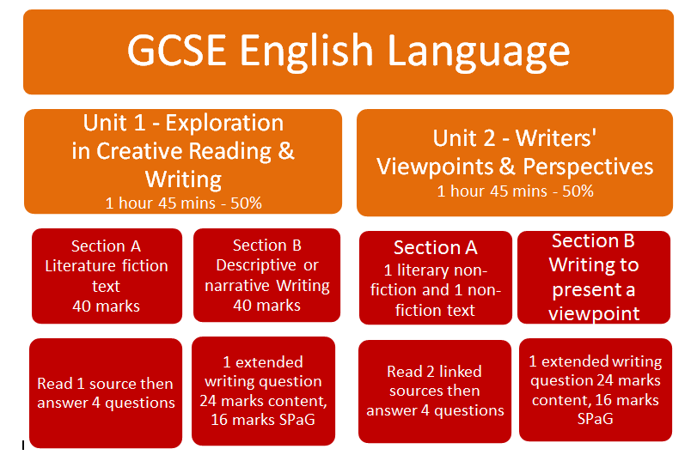

Slide 6

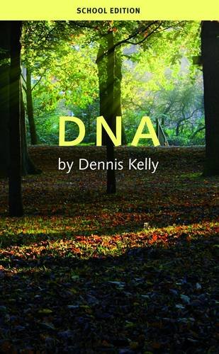

Which texts?
The Strange Case of Dr Jekyll and Mr Hyde
Macbeth
DNA
AQA Poetry Anthology – Power and Conflict cluster

Slide 7
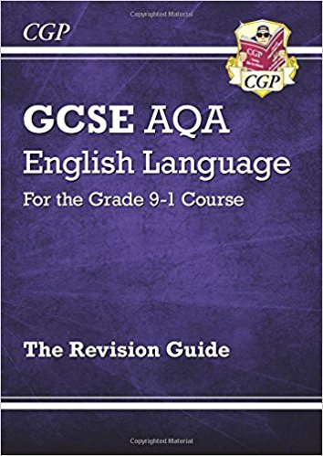
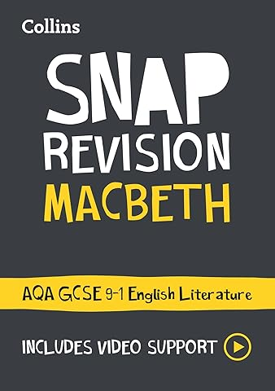
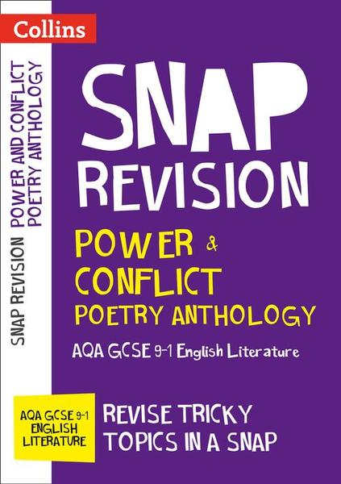
Which revision guides?
CGP http://www.cgpbooks.co.uk/books_gcse_english_new
Snap Revision Guides
York Notes

Slide 8
Which key skills are they being assessed on?
Reading:
Recall of key quotations
Discussion of connotations of key words
Identification and close analysis of language and structure features
Appreciation and application of context
Effect on the reader/audience
The ability to form an argument
Analysis - comparison - summary - evaluation

Slide 9
Which key skills are they being assessed on?
Writing:
Breadth of vocabulary
Language devices
Paragraphing
Crafting for purpose/audience/form
Punctuation
Sentence forms
Spelling

Slide 10

English revision methods
Re-reading exam texts (audiobooks)
Mind-maps for plot, characters, themes and contexts
Plan how to answer questions
Use past papers
Complete timed exam questions
Quote recall - create flashcards
Quotation analysis/explosions
Go over word classes and language devices
Quizzes
Google Classroom
Youtube tutorials / Seneca / BBC Bitesize / course hero
Ask your teachers!

Slide 11
Homework / Revision – support at home and at school
After School Revision
Thursday
1 hour in BS1
Starting with Literature texts: DNA, Macbeth, J & H – exam skills and revision resources
Revision in English lessons
Extended writing practice Friday (B) in a double lesson
Homework: families and teachers encouraging students to engage with revision ‘little and often’ via weekly revision
** Homework support after school on Tuesday E6
Weekly tutor revision sessions
Shorter activities:
Memorising quotes; Reading for inference; Plot quizzes; Watching short presentations on Literature texts
SPARX READER IS STILL AVAILABLE FOR Y11 – RE-READING LITERATURE TEXTS

Slide 12
Homework & Teacher Support
Set weekly
Week A – worksheet + online presentation (poetry focus in the winter term)
Week B – Writing and planning tasks to support extended writing / exam practice in class (Friday double lesson – Week B)
Timetabled - consistent across the department
Set on Arbor
After school support will be available every Tuesday in E6

Slide 13

All Revision sessions begin next week
21st September 2026
Students: please check emails and respond to invitations.
All Y11 students will be invited to join a
Y11 Revision Google Classroom. This is the main communication platform for updates about revision sessions and new revision resources. Please join.
If you have any questions: ask your child’s English teacher for help or contact Ms Young.
s.young@dmatschools.org.uk

