Slide 1

Year 11 GCSE Mathematics
Information Evening
Exam dates · Equipment · Homework · Revision · How to help at home
Tavistock College Mathematics Department
Notes:
30 seconds. Welcome, who you are, and the one-line promise: by the end of this you will know the dates, what to buy, and what to do at home. Then move on.
ADD: the date of the evening itself if you want it on screen.

Slide 2
The three exam dates
Pearson Edexcel GCSE (9–1) Mathematics — every paper is 1 hour 30 minutes, in the morning.
Paper 1
Paper 2
Paper 3
Non-calculator
Calculator
Calculator
Friday
Thursday
Monday
14 May 2027
27 May 2027
14 June 2027
Each paper is worth one third of the final grade. There is no coursework and no resit in Year 11.
Notes:
1 minute. This is the slide parents photograph — pause on it and say so.
Dates confirmed by SJTHOMAS: Paper 1 Friday 14 May 2027, Paper 2 Thursday 27 May 2027, Paper 3 Monday 14 June 2027. Worth a final check against the published Edexcel timetable nearer the time.

Slide 3
Mock exams
Two full sets of papers before the real thing.
Mock exams
Final mock
Week commencing
Week commencing
12 October 2026
22 February 2027
Revision for the first mock starts week commencing 22 September — that is this month, not next term.
Notes:
1 minute. The point of this slide is urgency: the first mock is weeks away, not months.
Mocks w/c Monday 12 October 2026 and w/c Monday 22 February 2027. Adjust 'that is this month' if you are presenting outside September.

Slide 4
Tiers and grades
Two tiers, one grade scale — and all three papers must be sat at the same tier.
1
2
3
4
5
6
7
8
9
Foundation tier
Safety net grade 3
3
Higher tier
Overlap — grades 4 and 5
Foundation tier
Higher tier
Grade 5 is the highest available. Grade 4 is a standard pass and grade 5 a strong pass — the grade most colleges and apprenticeships ask for.
The dashed 3 is awarded only to a student who misses grade 4 by a small margin. Below that safety net the result is a U — not a 2 or a 1.
Classes Y1, Y2, Y3 and Y4 are sitting Higher tier.
Every other class is being prepared for Foundation. Tiers are confirmed in the spring, on the evidence of the mocks.
Notes:
90 seconds. Walk the diagram left to right: the row of numbers is the whole grade scale, the red bar is what Foundation can award, the brown bar is what Higher can award, and the gap between the dashed lines is where they overlap.
The single most useful thing you can say is the U on Higher: below the safety net there is no grade 2 or 1, it is unclassified. That is what makes a wrong Higher entry expensive, and it is what parents of borderline students need to hear.
The red band answers the question you would otherwise be asked all evening. Read the class list aloud rather than just leaving it on screen.
The diagram follows Ofqual's illustration of tiering in GCSE mathematics (2013 technical consultation), redrawn in college branding.
CHECK BEFORE USE: confirm the Higher-tier class list is still Y1-Y4, and that 'every other class is Foundation' is accurate - I have inferred that from the four classes you named, not been told it.

Slide 5
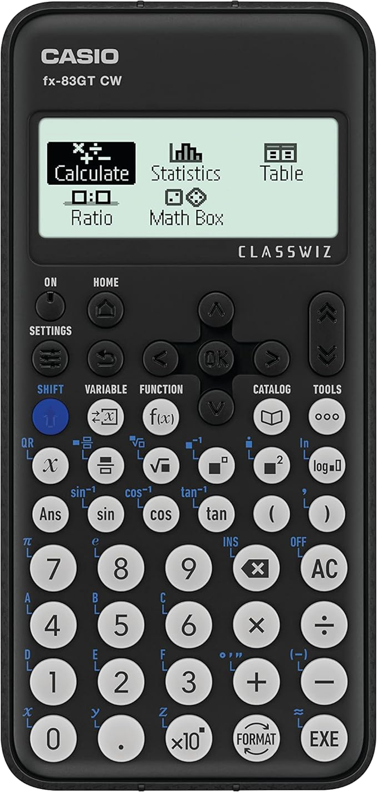
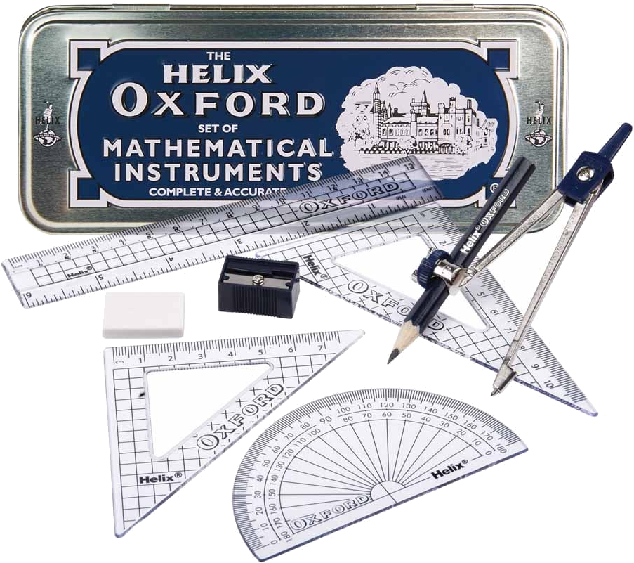
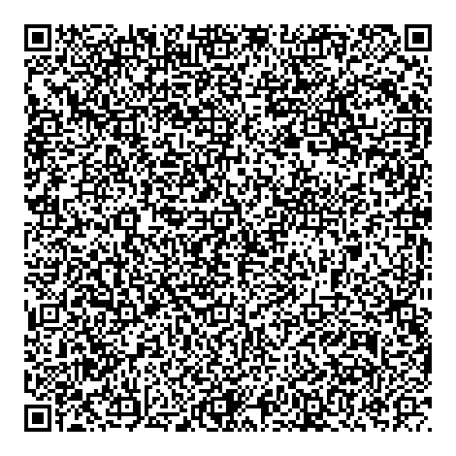
Equipment they need
Every lesson, every mock, every exam. Not borrowed on the day.
Casio FX-83GTCW
This is the model we teach from. Other calculators have the buttons in different places, which costs marks under time pressure.
Scan to buy
A maths set
Pen · Pencil · Ruler
Protractor · Pair of compasses
Notes:
1 minute. Hold up the actual calculator if you have one. The QR code goes straight to the Casio on Amazon.
CHECK BEFORE USE: if the school sells calculators or sets, say the price and where — that is more useful to parents than a QR code, and it should replace it.

Slide 6
Homework
Set weekly. Marked weekly.
Set every week
You can see it too
“I’ve done it all”
A past paper, or a section of one, is handed out by the class teacher each week and marked the week after. Not optional, and not extra.
It comes home on paper. Ask to see it before it goes back, and ask to see it again once it has been marked.
Completion is not the same as understanding. The useful question is what they got wrong, and whether they went back and redid it.
Notes:
2 minutes. This is where parents start paying closer attention, because it is the first thing they can act on.
The paper coming home is the whole point of this slide — it is the one piece of evidence a parent can physically pick up, unlike anything on a screen. Say so.
CHECK BEFORE USE: confirm the hand-out day and the return day so parents know when to expect a paper.

Slide 7
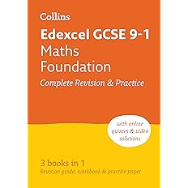
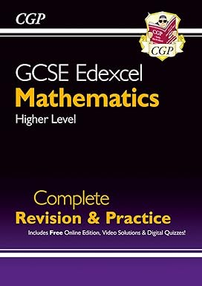
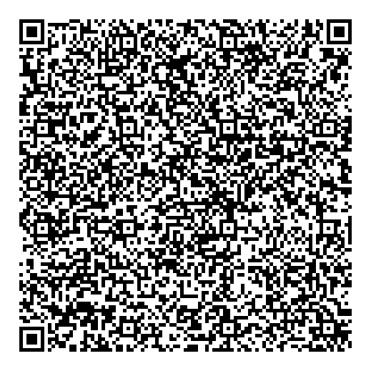
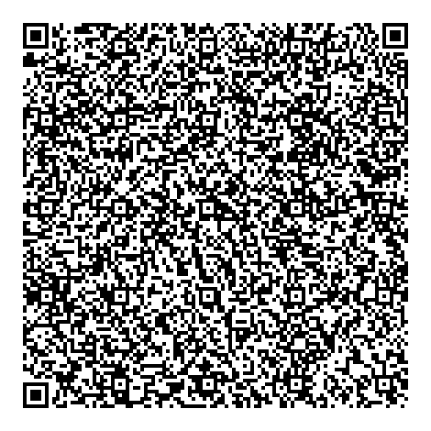
Revision guides
One guide, used properly, beats three on a shelf.
Collins
CGP
Foundation tier
Higher tier
Complete Revision & Practice
Complete Revision & Practice
Scan to buy
Scan to buy
Buy the one that matches the tier they are working at. If you are not sure, ask us before you buy anything.
Notes:
1 minute. The tier point is the one that saves parents money — make it explicitly.
CHECK BEFORE USE: the two QR codes are the ones from your original deck and go to Amazon listings. Swap them if the department recommends a supplier.

Slide 8
Where to revise online
Four sites. All free. All they need.
Maths Genie
Sparx Maths
mathsgenie.co.uk
sparxmaths.uk/student
Past papers and topics sorted by grade. Start here if they know their target grade.
Independent revision with a video for every question, chosen by topic.
Corbettmaths
YouTube
corbettmaths.co.uk
youtube.com
Every topic broken down, with a video and a worksheet. Good for one weak topic.
Full walkthroughs of whole past papers. Search the paper name and date.
Notes:
2 minutes. Do NOT demonstrate these live or walk through screenshots — that was eleven slides in the original and parents will not remember a website tour in September. Say what each one is FOR, in one sentence, and move on. The next slide has two short clips that do the showing for you.

Slide 9
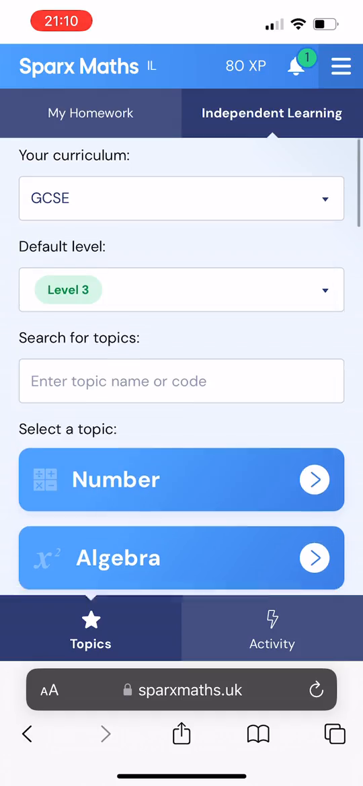
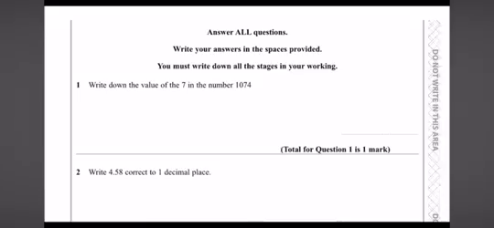
What good revision looks like
Two short clips — this is what to expect to see them actually doing.
Sparx — Independent Learning
YouTube — past paper walkthrough
Picking a topic to practise, outside of set homework.
A whole paper worked through, one question at a time.
Notes:
90 seconds MAXIMUM. Click each clip, let it run, talk over it — do not watch it in silence with the room.
The Sparx clip is 23 seconds and can run in full. The YouTube clip is 1 minute 39 — too long. Play roughly the first 30 seconds and stop it. To trim it permanently: click the video, Playback tab, Trim Video.
Both clips have been re-encoded to H.264 so they play on any Windows machine. The original YouTube clip was HEVC, which many school PCs cannot open without an extra codec from the Microsoft Store.

Slide 10
How you can help at home
Four things that make more difference than anything else tonight.
Revision means doing questions
Then mark it
Reading notes and watching videos feels like revision and is not. If nothing is being written down, it is not working. A past paper beats an hour of highlighting.
An unmarked page teaches nothing. Every answer sheet is on Maths Genie. The learning happens in the correcting, not the doing.
Short and often
Ask a better question
Twenty to thirty minutes, four or five times a week, starting now, beats a panicked fortnight in April. Consistency is the whole trick.
Not “have you done your homework?” but “what did you get wrong, and have you gone back to it?” The second one cannot be answered with a yes.
Notes:
4 minutes — the longest slide, deliberately. This is the only part of the evening parents can act on tonight, and it is the part your original deck was missing.
If you are short of time, cut anything else before you cut this.

Slide 11
Take a photo of this slide
Dates
Equipment
Revision websites
Mock exams
w/c 12 October 2026
Final mock
w/c 22 February 2027
GCSE papers
Paper 1 Fri 14 May 2027
Paper 2 Thu 27 May 2027
Paper 3 Mon 14 June 2027
Revision starts w/c 22 September
Casio FX-83GTCW calculator
Pen, pencil, ruler, protractor,
pair of compasses
mathsgenie.co.uk
Papers and topics by grade
sparxmaths.uk/student
Independent revision, with videos
corbettmaths.co.uk
Topic videos and worksheets
youtube.com
Full past paper walkthroughs
Revision guides
Foundation — Collins
Complete Revision & Practice
Higher — CGP
Complete Revision & Practice
Any questions — we are here all evening.
Notes:
2 minutes, then leave it up for the whole of questions. Say 'take a photo' out loud and then actually stop talking for five seconds so people can.
CONSIDER: print this as an A5 handout. A photo gets lost in a camera roll; a bit of paper ends up on the fridge.

