Slide 1
Succeeding in Science
Year 11 2026-2027
Agenda
What to expect in Year 11 Science
Exam Structure and key dates
Revision strategies and support
How Parents can help
Notes:
This font is Lexend and is the one all information should be on so if you copy and paste, please use ctrl+alt+v to paste using this format or change the format to Lexend if you haven’t changed the font.

Slide 2
Another Successful Year in Science…What did we learn?
Overall science results in the top 40% in the country
Triple Science results in the top 10% of the country.
National average for % 4-4s and above.
4 courses offered at post-16. Over 60 student places recruited to post 16 Science this year with over 100 studying post 16 Science in total. All 3 A-Level Sciences finished in the top 2% of the country
Attendance matters!
VA for students based on Attendance
<85% -0.344
85%+ +0.502
90%+ +0.531
95%+ +0.618
97%+ +0.714
Attendance 4+ in double science (62.4% in double overall)
Less than 80% attendance 4+ = 44%
90% attendance 4+ = 66.1% 5+ = 42.7%
95% attendance 4+ = 74.4% 5+ = 48.7%

Slide 3
Exams
Both Double and Triple have
• 6 exams in total
• Higher and foundation to choose between
Triple
• 2 exams for each subject
• Each exam is 1hr 45mins long
Double
• 6 exams for the double option
• Each exam is 1hr 15mins long

Slide 4
Key dates
October mocks are the 2 weeks before half term – Paper 1 content
Spring mocks are the 2 weeks after February half term – Paper 2 content (see handout)
Exam | Date | Time
Biology 1 | 11/05/27 | AM
Biology 2 | 10/06/27 | AM
Chemistry 1 | 17/05/27 | AM
Chemistry 2 | 15/06/27 | AM
Physics 1 | 25/05/27 | AM
Physics 2 | 18/06/27 | AM

Slide 5
What are the exams like?
Focus on practical theory assessment in the exams
On average, 20% of content will be maths based
Biology – 10%
Chemistry – 20%
Physics – 30%
Questions are ‘saw toothed’
• All questions start easier and then get harder
• Students must attempt the whole paper

Slide 6
Mock 1 - October
Paper 1s
The content covered will be as follows:
Biology: Cell biology; Organisation; Infection and response and Bioenergetics
  Which are B1- B9 in the revision guide or Specification topics 1-4
  10% Maths and Required practicals assessed within paper.
Chemistry: Atomic structure and the periodic table; Bonding, structure and the properties of matter; Quantitative chemistry; Chemical change and Energy changes
  Which are C1 - C7 in the revision guide or Specification topics 1-5
  20% Maths and Required practicals assessed within paper.
Physics: Energy; Electricity; Particle model of matter and Atomic structure
  Which are P1 - P7 in the revision guide or Specification topics 1-4
  30% Maths and Required practicals assessed within paper.

Slide 7
Mock 2 - February
Paper 2s
Content covered as follows, but any understanding of fundamental principles from Paper 1 can be assessed in Paper 2. Maths and required practicals are assessed in the same proportions as in paper 1.
Biology: Homeostasis and response; Inheritance; Ecology
  Which are B10 - B18 in the revision guide or Specification topics 5-7; homeostasis and response, inheritance, variation and evolution, ecology.
Chemistry: The rate and extent of chemical change and Organic chemistry
  Which are C8 - C15 in the revision guide or Specification topics 6-10. Rates of reaction and equilibria, organic chemistry, chemical testing and environmental science (atmosphere and resources)
Physics: Forces and Waves
  Which are P8 - P15 in the revision guide or Specification topics 5-7; forces and motion, waves, electromagnetism (Light and Space – Triple only).

Slide 8
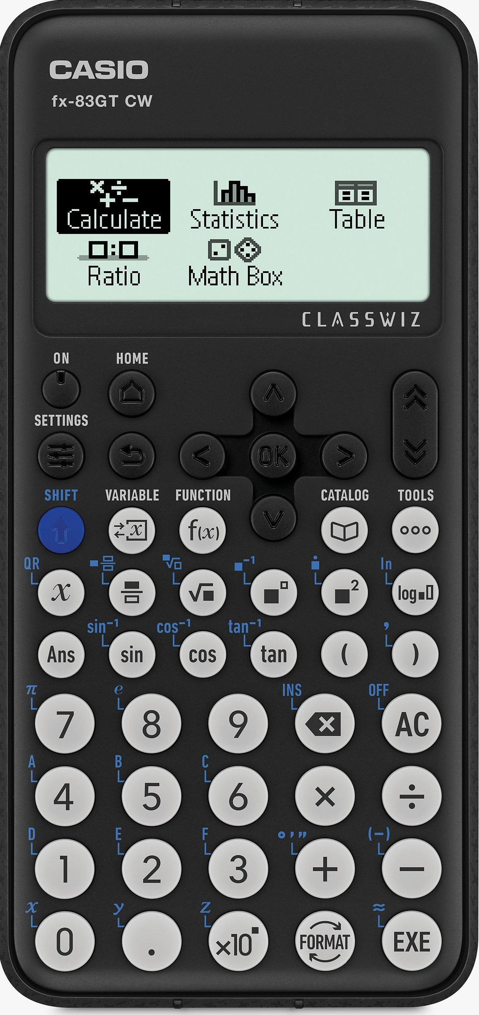
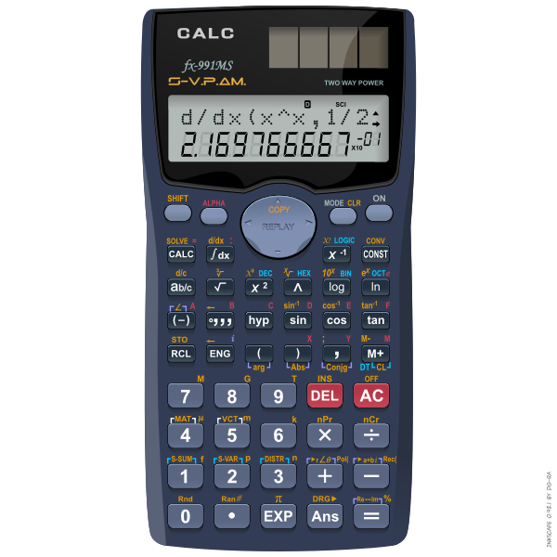
Equipment
Black pens
30cm ruler
Pencils
Rubber
Pencil sharpener
Scientific Calculator
Protractor

Slide 9
The Courses
We follow the AQA specification for all our courses.
11ATT-11DAR are studying AQA Combined Science Trilogy Foundation Tier (FT). Students will achieve 2 GCSE grades ranging from 1-1 to 5-5.
11ELI + FEY are studying AQA GCSE Combined Science Trilogy Higher Tier (HT) but are currently operating as a mixed set and we will use the next mock data to make decisions about tiers. Students will take BOTH FT and HT papers in mock 2 for a final determination of tier of entry.
11GAL and 11NEW are currently Studying AQA Combined Science Trilogy Higher Tier (HT). Students will achieve 2 GCSE grades ranging from 4-3 to 9-9
11HAL are Studying AQA Single Science (Triple Science). Students will achieve 3 distinct grades ranging from 3-9

Slide 10
What do students need to do?
Revise consistently for Science on a regular basis. We would suggest 45mins a night (roughly 20mins per GCSE)
It is important that this is regular in smaller doses – a prolonged revision session does not always help – Focus on Uplearn
One day should be taken off from revision/schoolwork each week
Plan out to cover all the areas that are in their exam
Revise the material, then practice the exam questions, then mark

Slide 11
How are we helping students?
All students will have a revision guide for Science (in the next 2 weeks)
We are providing after school revision every Monday from November
There is a range of revision materials on Google classroom
We will provide 2 full sets of past papers for students to practice (Next week)
We have 5 sets of each papers to go through in class / set as homework
Uplearn + Seneca
Kerboodle / lost learning

Slide 12
Key dates
October mocks are the 2 weeks before half term – Paper 1 content
Spring mocks are the 2 weeks after February half term – Paper 2 content (see handout)
Exam | Date | Time
Biology 1 | 11/05/27 | AM
Biology 2 | 10/06/27 | AM
Chemistry 1 | 17/05/27 | AM
Chemistry 2 | 15/06/27 | AM
Physics 1 | 25/05/27 | AM
Physics 2 | 18/06/27 | AM

